Slide 1
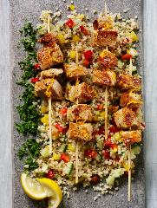
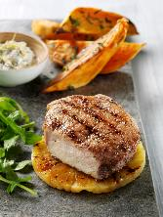
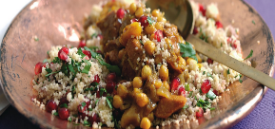
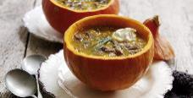
Food Presentation and Styling

Slide 2
We ‘eat with our eyes’
A stunning plate of food appeals to our visual taste as well as our palette.
Food Presentation is the art of modifying, arranging or decorating food to enhance it’s aesthetic appeal.
Improving the presentation of a dish adds value to the dining experience and can enable chefs and restaurants to charge more for their food.

Slide 3
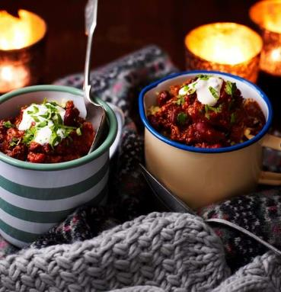
Considerations For Great Food Styling and Presentation.
The support (what the food will be served on)
The focal point
Colours
Textures
Decoration and garnish

Slide 4
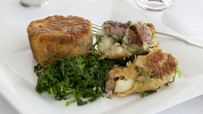
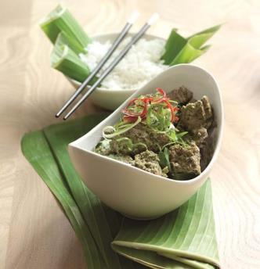
1. Support
The function of the support is to present and reveal the culinary preparation. Its patterns and colours should not interfere with food. Its size should be proportional to the food volume and not give the effect of excess or insufficient food.
For these reasons, professionals most often use plain dark or white plates to express their creativity.

Slide 5
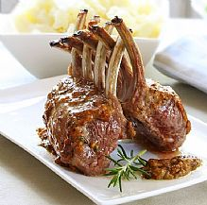
2. Focal point
The focal point is what will mainly attract the eye. It may be the highest element of the composition or it could be the point with the most volume.
For a main dish, this place is often occupied the meat, fish or protein alternative.

Slide 6
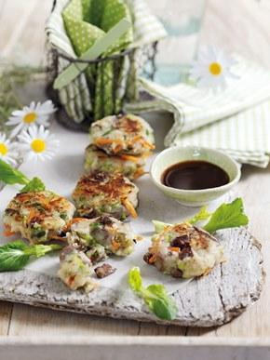
3. Colour
Colour is very important because it can create excitement. Green brings coolness and calms down. Red stands for passion and excitement. Black is a sign of elegance.
However, blue is a natural appetite suppressant and can make food look unappetising, which is why you won’t find restaurants serving on blue plates.

Slide 7
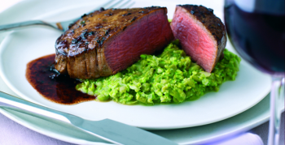
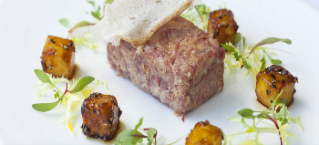
3. Colour
The use of vegetables and their contrasting colour and shape are important.
Care must be taken to use their shape and colour wisely, in a way that presents them without hiding other elements of the dish.

Slide 8
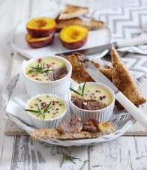
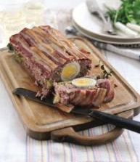
4. Texture
Texture is a critical component of good food presentation.
Contrasting textures are made by different preparation methods.
By contrasting firm and soft, silky and rigid textures, the whole dish takes on a higher dimension and adds a visual interest.

Slide 9
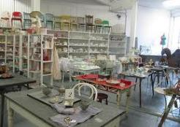
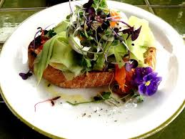
5. Decoration and Garnish
Plates and props include chopping boards, slates, serve food in unusual dishes
Good finds in charity shops and car boot sales (and parents/grandparent’s lofts!)
Garnishes or decorative techniques should be functional and edible, with exceptions such as skewers and speciality utensils.
They should always enhance and flavour food. They should add contrasting colour, texture and overall interest.

Slide 10
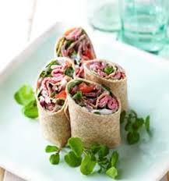
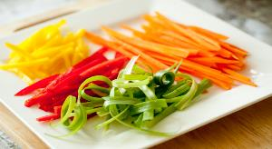
5. Decoration and garnish
Edible decoration could include:
Fresh herbs or dried spices
Toasted nuts, sesame or pumpkin seeds
Julienne strips or ribbons of vegetables
Twists of citrus fruit, shaped or carved vegetables
Crispy croutons

Slide 11
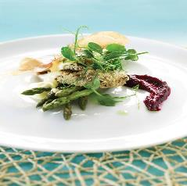
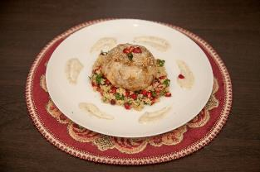
5. Decoration and garnish
Coarsely crushed peppercorns
Grated citrus zest
Edible flowers such as nasturtium, elderflower and cornflower or pea shoots
Edible herb flowers such as chive, garlic and fennel
Swirled, brushed, painted or piped cream, half fat crème fraiche, jus or compotes.

Slide 12
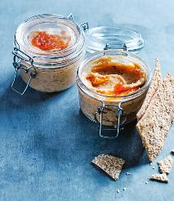
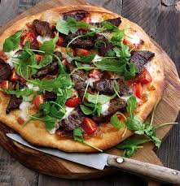
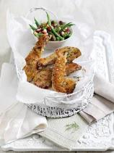
Tips for dressing a plate
Increasingly, modern chefs often use alternative ways to present their food such as paper cones for chips, preserving jars for pâté, individual lidded dishes for casseroles, mini saucepans for soups and natural stone or wooden plates.

Slide 13
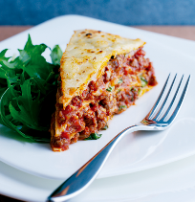
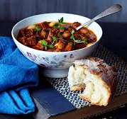
Tips for dressing a plate

Slide 14
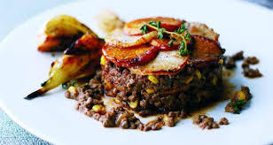
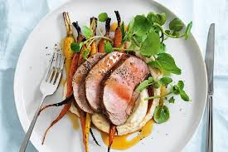
Tips for dressing a plate
Also, the smaller the portion, the easier it is to create compact, elegant servings.

Slide 15
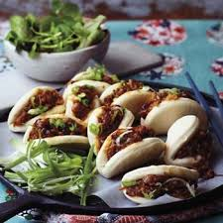
Tips for dressing a plate
Follow the rule of odds - having an odd number of elements on a dish is more visually appealing than having an even number.
It creates the impression that a piece of food is being framed by the others.

Slide 16
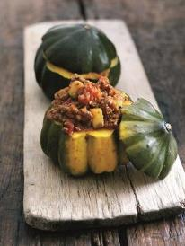
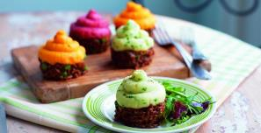
Tips for dressing a plate
Use of vibrant colours – liven up your plate with vegetables or sauces in bright sharp colours, especially if the dish has a dark colour such as a steak or casserole.

Slide 17
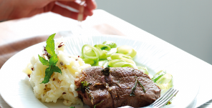
Tips for dressing a plate
Food positioning – if faced with lots of ingredients, the classic way to plate it is to ‘clock it’.
Place the potatoes, pasta or rice at ten o’clock, meat or fish at six o’clock and the vegetables at two o’clock.

Slide 18
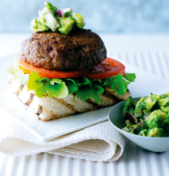
Tips for dressing a plate
Elevation – stack meat, fish, eggs or cheese over starch components such as rice, pasta and couscous in a tight pyramid or cylinder for the ‘wow factor’.

Slide 19
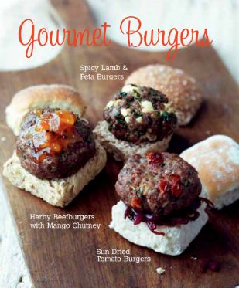
Tips for dressing a plate
Repetition of ingredients – lay three small identical pieces of protein side by side with different garnishes on each one to add visual interest.
Repetition is an easy way of creating a picture.

Slide 20
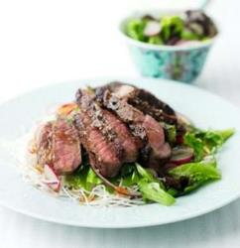
Tips for dressing a plate
Make sure the plate is clean – after going to the trouble to present your food beautifully, make sure you don't serve it on a dirty plate and make sure presentation is double-checked before serving.

Slide 21
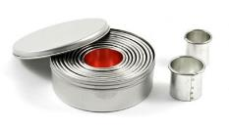
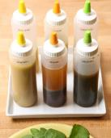
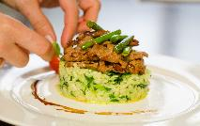
Tools for presentation and styling
Tweezers/small spoon – useful for positioning small, delicate pieces of garnishes.
Plain/fluted biscuit cutters – these are great tools for creating shapes to layer meat, fish and vegetables. The thinner the layers, the more impressive the outcome.
Paintbrush or squeezy bottle – use these to creatively add sauces in a creative and controlled way.

Slide 22
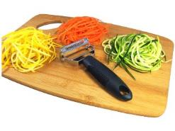
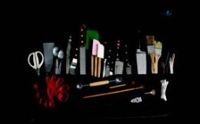
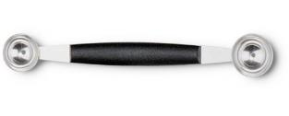
Tools for presentation and styling
Melon baller, julienne peeler and apple corer – use these to create attractive garnishes with fruit and vegetables.
Palette knife – to smooth the sides or tops of dishes and ease removal of dishes from moulds or rings.
Piping bags and nozzles – create attractive decoration and garnishes on sweet and savoury dishes using different sized/ shaped nozzles.

Slide 23
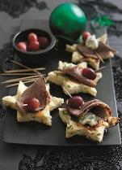
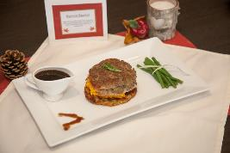
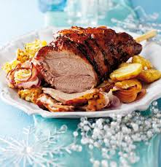
Props
Try to include props as part of your overall food presentation, such as flowers, napkins, glassware, cutlery, tablecloths and a menu.
If you are producing a dish or menu based on a theme or culture include appropriate decorations and cutlery such as Christmas baubles for a yuletide dish.

Slide 24
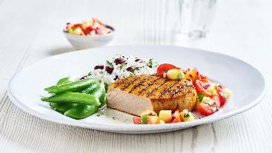
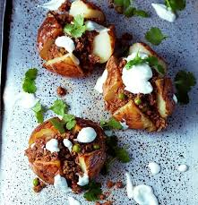
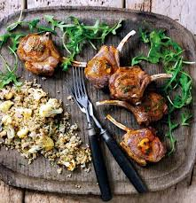
Food Trends
And finally …
Keep on top of food presentation and styling trends by engaging with food websites, reading food magazines, watching cookery programmes and following food various blogs.

